Slide 1
Final Project DEMO
DC Lab Spring 2025
team 09 / 丁睿濂、林靖軒、劉代恩

Slide 2
Outline
Introduction
Implementation Details
Connections
Display
Block Diagram
Novelty

Slide 3
TRAIN SIMULATOR

Slide 4
BASIC functions
Input:
Joystick (acceleration, brake, ...) → FPGA
Computer (video frames & speed labels) → FPGA
Function:
Receive control from joystick and calculate speed correspondingly
Communicate with PC to receive frames and display video accordingly
Output:
FPGA → Monitor (show video, speed, distance, and score)

Slide 5
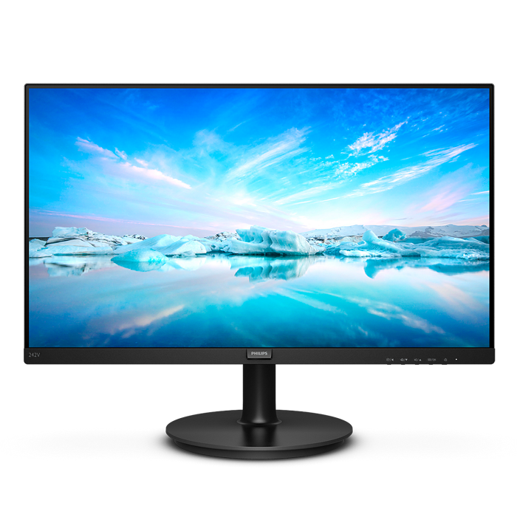
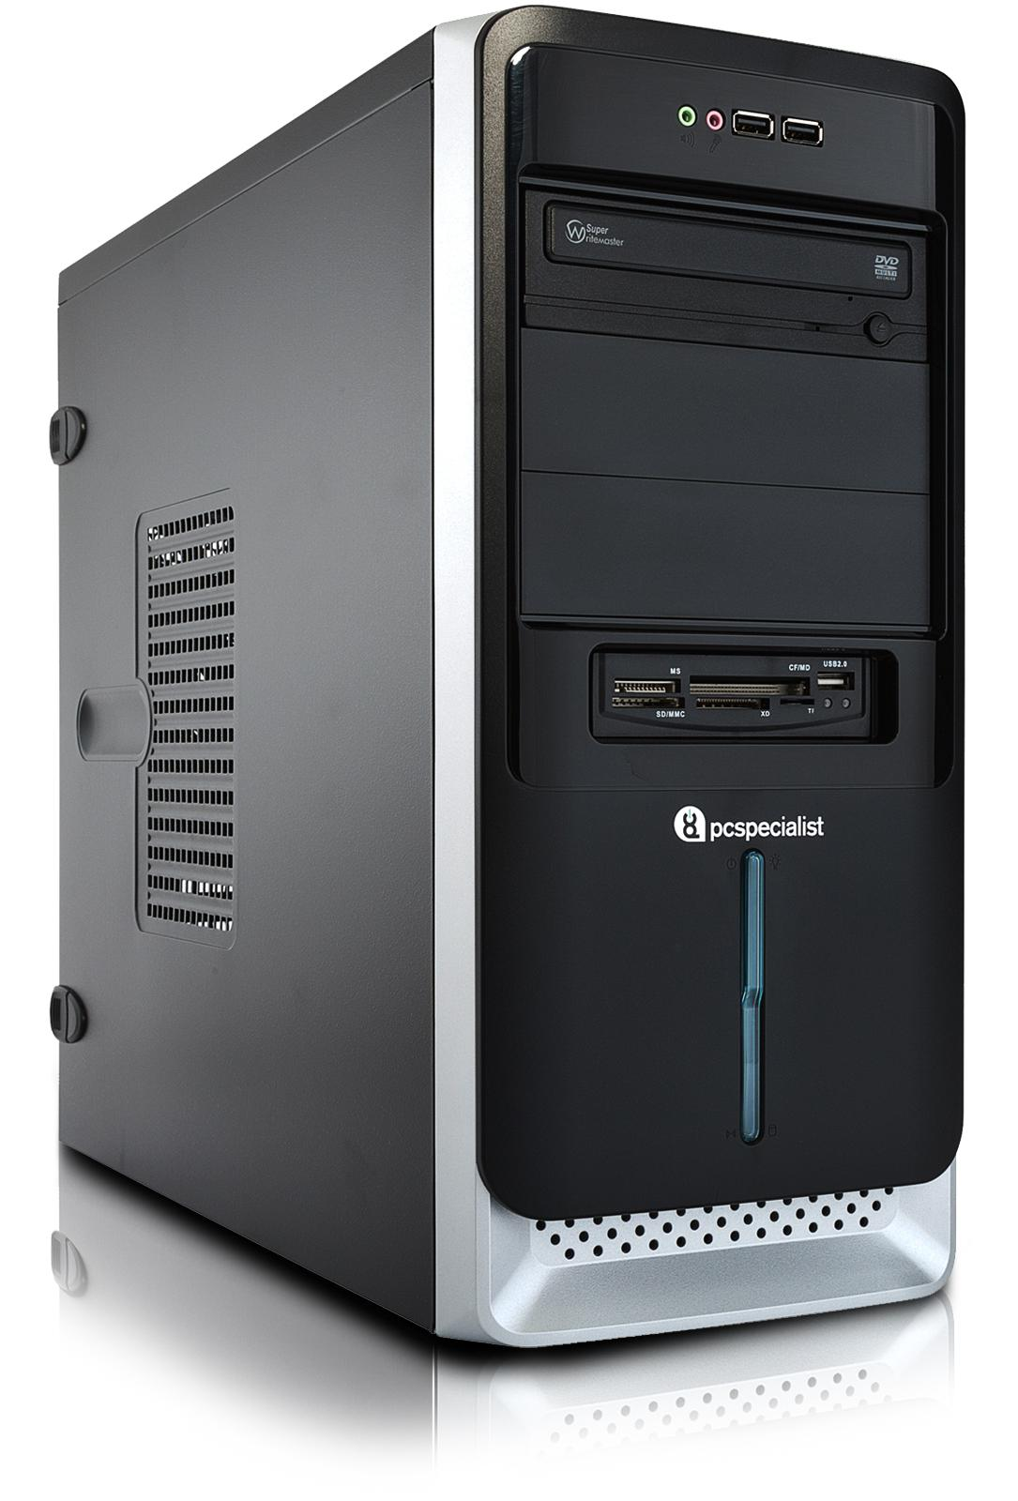
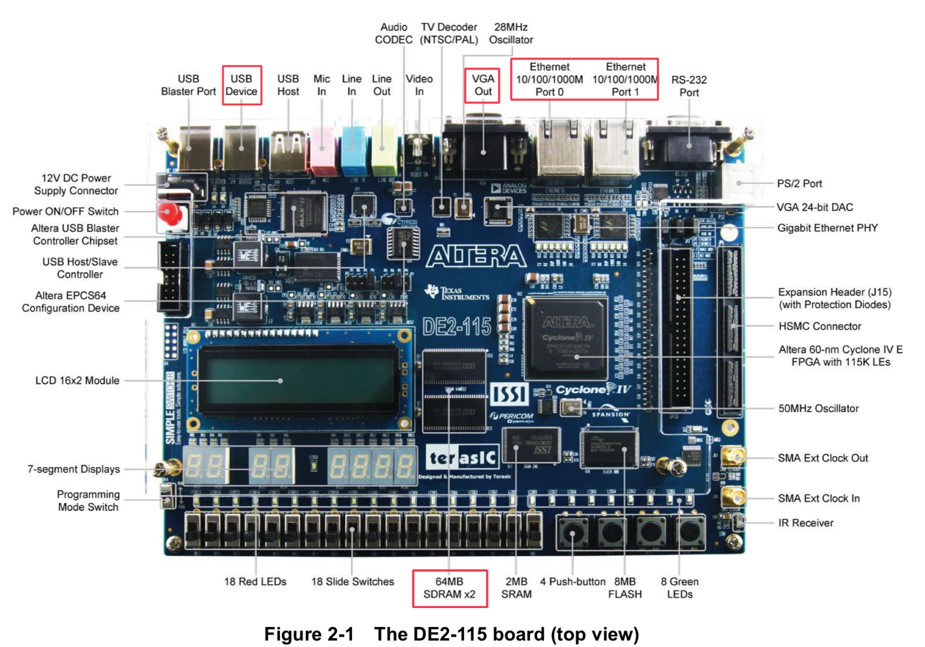
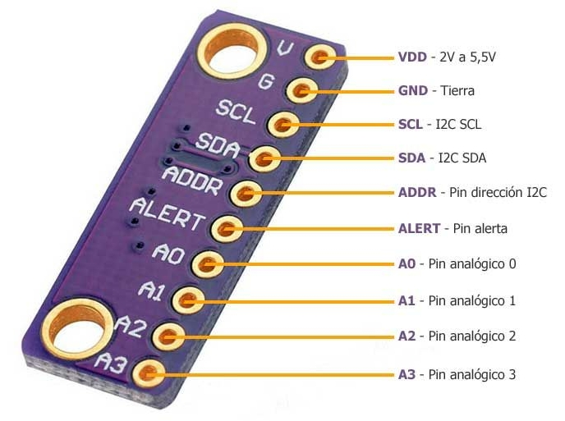
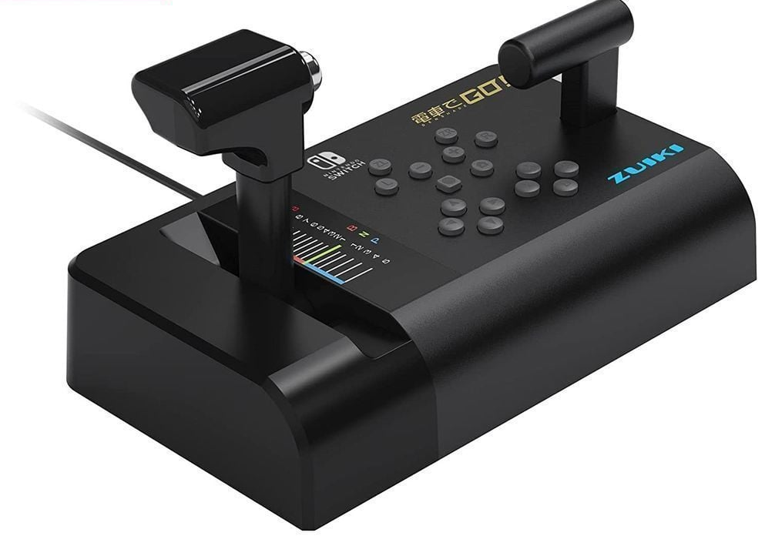
CONNECTIONS
Monitor
PC
ADC Module
Joycon

Slide 6
Connections
GPIO (joystick → FPGA): control playback speed by acceleration and brake
Use potentiometer and ADC module (ADS1115) to communicate with FPGA
Support I2C protocol
Use Arduino and logic analyzer to understand the protocol:
Initialize
Set Config Register
Select Config Register
Write Config Register Settings (channel)
Read Config Register Settings
Read Conv Register
Select Conv Register
Read Conv Register

Slide 7
Connections
Ethernet (PC → FPGA): send video frames and return speed labels
https://github.com/alexforencich/verilog-ethernet
Parse data packets on FPGA based on data format to handle data correctly
Add header to packets can help FPGA distinguish different data type
IP configuration:
PC: 192.168.50.7
FPGA: 192.168.50.8
Both PC and FPGA have to be connected to the same router.
Also supports FPGA → PC connection

Slide 8
Connections
VGA (FPGA → Monitor): output corresponding video
Support resolution: 640*480, 30FPS
VGA_control is modified from Terasic

Slide 9
Display
Value of basic features
Speed: calculated from current speed and joystick’s value
Distance to next station: send labels from PC through Ethernet
Remaining time: counted in FPGA
Display
Store images of 0~9 in registers

Slide 10
Block diagram
SDRAM
Joystick
ADS
Speed Control
SDRAM Control
VGA Control
Monitor
UDP parser
DE2-115
7-Seg display
PC
Ethernet Connection
Sound Player

Slide 11
Finite state machine

Slide 12
novelty
Flexibility
Download any video and start playing after few processing
Deal with protocols between FPGA and joystick
Low latency & real-time data handling
FPGA provides faster response times, which is a fit for real-time data processing

Slide 13
Reference
DE2-115 User Manual
https://www.terasic.com.tw/wiki/images/f/f2/DE2_115_manual.pdf
Ethernet
https://medium.com/@Frank_pan/how-to-use-ethernet-components-in-fpga-altera-de2-115-26659da06362
https://github.com/alexforencich/verilog-ethernet
SDRAM
邏輯電路設計DE2-115實戰寶典
Vehicle Speed Estimation
shafu0x/vehicle-speed-estimation: Vehicle Speed Estimation from Video using Deep Learning and Optical Flow in PyTorch.

